Slide 1
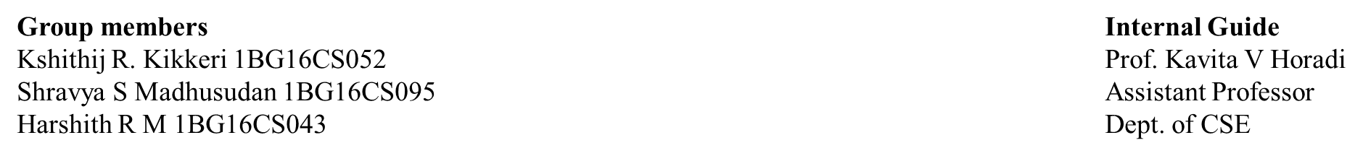
Controlling Adulteration in Public Food Grain Distribution

Slide 2
Outline
Introduction
Literature Survey
Problem Statement
Description of Dataset
System Design
Block Diagram
Data Flow Diagram
Sequence Diagram
Test Cases
Results
Performance Evaluation

Slide 3
Introduction
India is an agriculture-based country which contributes around 17% of the GDP
Characteristically, there is a large amount of food grains produced by India which is stored by the Food Corporation of India(FCI)
A part of this vast amount of grains are reserved to be distributed to the poor and the needy by the Government through various schemes
There are a lot of loopholes which hamper the existing system which is highly influenced by the bureaucracy

Slide 4
Introduction
The food distribution system of the present day is bound to have various problems which are initiated at Fair Price Shops (FPS)
This includes malpractices by FPS dealers such as diverting the food allocated for BPL (Below Poverty Line)
Also there is no convenient method to identify these inferior quality grains which is used by the Government
Human perception has long been recognized as a guide to quality assessment but the results are not accurate and is unreliable.

Slide 5
Literature Survey
[1] Syed Ali et al, “Low Cost Solution for Rice Quality Analysis using Morphological Parameters and its Comparison with Standard Measurements” 20th International Multitopic Conference (INMIC’1) 978-1-5386-2303-9/17 ©2019 IEEE
The main aim of this research is to provide a low cost software product that mimics all the features and characteristics of this software
103 rice grains were taken for the classification of rice grains. Features which include length, width, area, uneven particles, grains of other colors are taken into consideration for classification
The results obtained in terms of percentage accuracy of average length and average width of rice grains are 95.04 and 95.45 respectively
Advantage: Provides a low cost solution for classification using advanced techniques
Disadvantage: Not reliable and not universally applicable.

Slide 6
[2] Harpreet Singh et al, “ Image Processing Techniques for Analysing Food Grains”, International Conference on Computing Methodologies Communication (ICCMC) 978-1-4244-7164-5 ©2019 IEEE
In this system the grain Parameters for grading are Aspect Ratio, weight(to obtain density and size of the grains), Texture, Chalkiness, Whiteness, Length and Width
The techniques which is used to extract these features, Kernels separation by Sieving method, Grain analysis by Digital Image Analysis seed count, Rice grain analysis by Image acquisition, Kernel quality analysis by Automatic grain quality inspection
The four techniques which are involved in quality analysis gives a precise reading on the quality of the rice grains
This technique is useful for analysing huge quantity of grains and requires less intervention of an operator
Advantage: Provides wide ranging techniques for analysing food grains.
Disadvantage: Does not concentrate on the implementation of the elaborated techniques

Slide 7
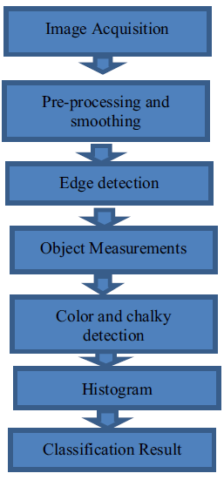
[3] Zahida Praveen et al, “ Assessment of Quality of Rice Grain using Optical and Image Processing Technique”, International Conference on Computing Methodologies Communication (ICCMC) 978-1-4244- 7164-5 ©2017 IEEE
In this Algorithm they have calculated the chalkiness and used various color models such as RGB and HSV color models
These features are analysed on the histogram to determine the quality of the rice grains
The results of the histogram is measured and listed in a table.
Results are based on area, length, width and chalkiness.
Advantage: Almost accurately calculates the percentage of chalky area of the rice grain
Disadvantage: Validation of the research relies on visual inspection

Slide 8
[4] Muhammad Junaid Asif et al., “Rice Grain Identification and Quality Analysis using Image Processing based on Principal Component Analysis” 978-1-5386-8204-3/18 ©2018 IEEE
Research on this paper shows an image processing-based solution to classify the different varieties of rice and its quality analysis using an approach based on the combination of principal component analysis and canny edge detection
The morphological features used for classification are eccentricity, major axis length, minor axis length, perimeter, area and size of the grains
Results obtained in terms of classification and quality analysis are 92.3% and 89.5% respectively
Advantage: Uses algorithms like Principal Component Analysis which makes the research robust
Disadvantage: The accuracy of the proposed system is very less

Slide 9
[5] Deepika Sharma et al, “Grain Quality Detection by using Image Processing for public distribution”, International Conference on Intelligent Computing and Control Systems 978-1-5386-2745 ©2017 IEEE
The work in this Research states that the processing of grains can also be done using Neural Network classifier
The work proposes classification through feature extraction keeping the features as Area, Major axis length, Minor axis length, Perimeter
The testing process involves Image Pre-Processing, Segmentation Image Binarization, NN Classifier
The grains are classified into ‘Good’, ‘Average’, and ‘Bad’ with an accuracy of 82%
Advantage: Most sturdy system which implements IoT and Image Processing which is useful for the society.
Disadvantage: No research done on the accuracy of the grain classification

Slide 10
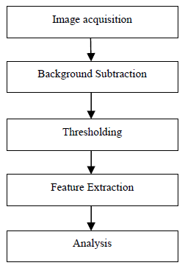
[6] Shraddha N. Shahane et al, “Grain Quality Assessment for Rationing System”, Online International Conference on Green Engineering and Technologies 978-1-5090-4556 ©2016 IEEE
The System which is proposed checks the quality of the Wheat Sample
using features such as size, shape, eccentricity, perimeter etc
In this Algorithm the steps which are involved to assess the
food grains are shown
The results obtained would be accurate and it gives a
cost effective solution for assessment of the food grains
Advantage: It replaces manual inspection by machine vision
Disadvantage: The idea is not reliable since it is not implemented

Slide 11
[7] Megha R. Siddagangappa et. Al, “Classification and Quality Analysis of Food Grains,” IOSR Journal of Computer Engineering (IOSR-JCE), Aug. 2014
Identification of rice varieties based on their characteristics has been done using Probabilistic Neural Network(PNN) approach
Three well known rice varieties were used in tests. This paper proposes a model that uses colour and geometrical features as attributes for classification
The grading of rice sample is done according to the size of the grain kernel and presence of impurities
A good classification accuracy is achieved using only 6 features, mean of RGB colours and 3 geometrical features. Tests on the system for the test sets show accuracy of 98% and grading of rice is 90% to 92%.
Advantage: Uses most advanced PNN algorithm which gives a high degree of accuracy
Disadvantage: The percentage of accuracy would have been more if Sobel edge detector was used instead of Canny edge detector in the pre-processing stage

Slide 12
References | Data set | Pre-Processing techniques | Extracted features | Color Spaces | Training | Criteria | Average accuracy
Syed Ali et al., (2019) | 103 rice Grains | Filter, dilation, ersion | Length, width, area, uneven particles, grains of other colors | RGB | N/A | Accuracy | 95%
Harpeet et., al (2019) | Mixed rice samples | Physical | Length, width, aspect ratio, chalkiness, texture | N/A | N/A | N/A | N/A
Parveen, et al., (2017) | 22 rice grains | Smoothing | Area, Length, Width, Chalkiness | RGB, HSV | N/A | Recognition rate | N/A
Junaid et al., (2018) | Varieties | Filtering | Length, width, aspect ratio, | grayscale | feed-forward neural network | Accuracy | 89.5%
Deepika et al., (2017) | Mixed Wheat Samples | Filtering, Noise Removal | Area, Major and Minor Axis Length, Perimeter | grayscale | Nil | Recognition rate | 75%
Sahane et al., (2016) | N/A | N/A | Area, length, perimeter | N/A | N/A | N/A | N/A
Megha. et al., (2014) | 12 types of grains | Filter, dilation, erosion | Colour, Geometrical | Grayscale | Probabilistic Neural Networks | Accuracy | 92%

Slide 13
Problem Statement
The existing system proves the inability of the bureaucratic setup which has failed to deliver good quality grains to the needy. The aim of this project is to overcome the failures of the present system and to design an automated grain recognition which performs quality analysis of rice grains using its features, which classifies the type of grain and its quality and grade.

Slide 14
Description of Dataset
The dataset is partly obtained from GitHub repository taken by a well-known open source contributor and partly acquired by us.
All the grain images stored in a database in a .jpeg file extension. The images are already labelled as good, average and bad quality grains.
The training data is comprised of 1,500 images, which are augmented before training.

Slide 15
Existing System
The existing systems suggest that the manual classification and segregation can be done using the processes of sieving, cleaning, milling among the others.
On the other hand, automated process using advanced techniques are done using algorithms like K-Means clustering algorithm, K-Nearest neighbor algorithm, morphological feature extraction and Detection.
Not highly secure and hence leads to inconsistency and tampering of food grains for illicit purposes.
Immediate disbursal of the food grains does not take place which results in rotting of food grains due to inexplicable weather conditions.

Slide 16
Proposed System
Prima facie, capture the image of the grain using a digital camera
Store them in the database file, read that database file and then pre-process the image
Extract the features from each image, store the extracted features in feature vector for training
The features of the HOG, GLCM, Chalkiness of the rice grains are considered in order to grade them for quality
Build the Probabilistic Neural Network (PNN) for training and recognizing the grain type and its quality
Finally, test the system by giving different images as input

Slide 17
Introduction to Probabilistic Neural Networks
A probabilistic neural network (PNN) is a feedforward neural network, which is widely used in classification and pattern recognition problems.
In the PNN algorithm, the parent probability distribution function (PDF) of each class is approximated by a Parzen window and a non-parametric function.
Then, using PDF of each class, the class probability of a new input data is estimated and Bayes’ rule is then employed to allocate the class with highest posterior probability to new input data.
By this method, the probability of mis-classification is minimized

Slide 18
Introduction to Probabilistic Neural Networks
When an input is presented, the first layer computes distances from the input vector to the training input vectors and produces a vector whose elements indicate how close the input is to a training input.
The second layer sums these contributions for each class of inputs to produce as its net output a vector of probabilities.
Finally, a compete transfer function on the output of the second layer picks the maximum of these probabilities, and produces a 1 for that class and a 0 for the other classes.

Slide 19
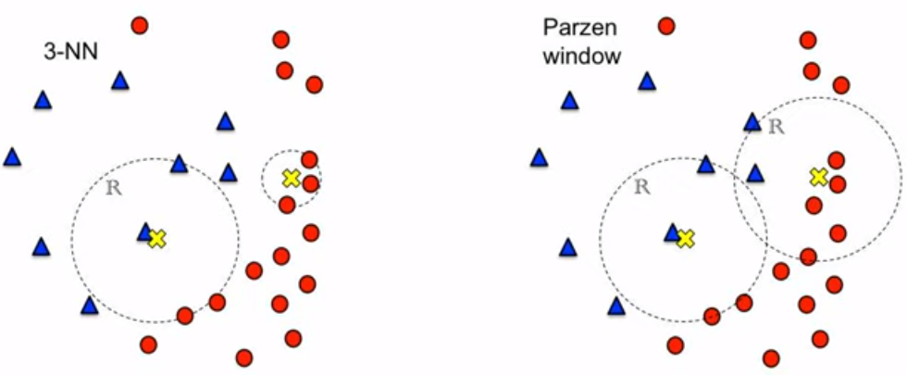
Elementary concepts – Parzen Windows

Slide 20
Elementary Concepts – Radial Basis Functions
A radial basis function (RBF) is a function that assigns a real value to each input from its domain (it is a real-value function), and the value produced by the RBF is always an absolute value
PNNs use Radial Basis Functions (RBFs) as activation function in the second layer to make a local decision function centred on a sample input space
PNN, in theory is a special form of RBF network used for classification.

Slide 21
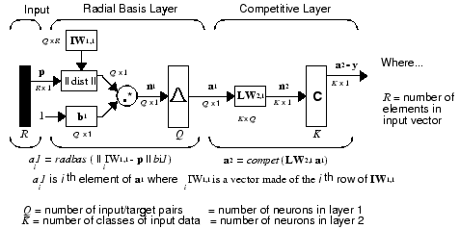
Introduction to Probabilistic Neural Networks

Slide 22
Introduction to Probabilistic Neural Networks
The first-layer input weights, IW are set to the transpose of the matrix formed from the Q training pairs, P’.
When an input is presented, the || dist || box produces a vector whose elements indicate how close the input is to the vectors of the training set.
These elements are multiplied, element by element, by the bias and sent to the radbas transfer function.
An input vector close to a training vector is represented by a number close to 1 in the output vector a.
If an input is close to several training vectors of a single class, it is represented by several elements of a that are close to 1.

Slide 23
Introduction to Probabilistic Neural Networks
The second-layer weights, LW^{1,2}, are set to the matrix T of target vectors.
Each vector has a 1 only in the row associated with that particular class of input, and 0s elsewhere.
The multiplication Ta¹ sums the elements of a¹ due to each of the K input classes.
Finally, the second-layer transfer function, compet, produces a 1 corresponding to the largest element of n², and 0s elsewhere.
Thus, the network classifies the input vector into a specific K class because that class has the maximum probability of being correct.

Slide 24
Introduction to Probabilistic Neural Networks

Slide 25
Introduction to Probabilistic Neural Networks
Advantages
Training speed is many time faster than a BPNN.
Training is easy and instantaneous. Weights are not trained but assigned.
PNN networks generate accurate predicted target probability scores
Training samples can be added or removed without extensive retraining
Guaranteed to converge to an optimal classifier as it approaches Bayes optimal result under easily met conditions.
Disadvantages
The size of the network tends to be equal to the size of the training dataset which makes it almost impractical for use with large scale databases.
Performance decreases in terms of accuracy and speed with a large dataset
Classification of new cases can is tedious in terms of speed and accuracy
Large memory and time requirements for execution

Slide 26
HOG Feature
HOG is a feature descriptor used to detect objects in computer vision and image processing
The technique counts occurrences of gradient orientations in localized portion of the image
It is computed on a dense grid of uniformly spaced cells
It uses overlapping local contrast normalization for improved accuracy
It focuses on structure and shape of the object.
Histograms are created using gradients and orientation of the pixel value. Hence the name Histogram of Oriented Gradients

Slide 27
Chalkiness Feature
Chalkiness is the opaque area in the rice grain. Chalky areas are formed due to malformed starch granules with air space between them.
Chalkiness disappears upon cooking and has no effect on taste or aroma, however it downgrades milled rice
Chalkiness is caused by interruption during the final stages of grain filling
It is required to find the milky colour percentage in the grain. Based on the percentage value, grain can be classified as a chalky grain or a normal grain.

Slide 28
Calculation of Chalkiness
Establish a threshold value.
Consider the binary image of the given input and fill all holes
Blob identification and measurement
Create another threshold value
Take masked binary image and fill all holes
Subblob identification like step 3
Take perimeter of blob and subblob
Determine percentage of chalkiness using the formula
%of chalkiness=subblob perimeter/blob perimeter *100

Slide 29
GLCM Feature
The Gray Level Co-occurrence Matrix (GLCM) method is a way of extracting second order statistical texture features
In statistical texture analysis, texture features are computed from the statistical distribution of observed combinations of intensities at specified positions relative to each other in the image
According to the number of intensity points (pixels) in each combination, statistics are classified into first-order, second-order and higher-order statistics
A GLCM is a matrix where the number of rows and columns is equal to the number of gray levels, G, in the image

Slide 30
GLCM Feature
The matrix element P (i, j | Δx, Δy) is the relative frequency with which two pixels, separated by a pixel distance (Δx, Δy), occur within a given neighbourhood
One with intensity ‘i’ and the other with intensity ‘j’
Using a large number of intensity levels G implies storing a lot of temporary data a G × G matrix for each combination of (Δx, Δy)
Due to their large dimensionality, the GLCM’s are very sensitive to the size of the texture samples on which they are estimated
Thus, the number of grey levels is often reduced

Slide 31
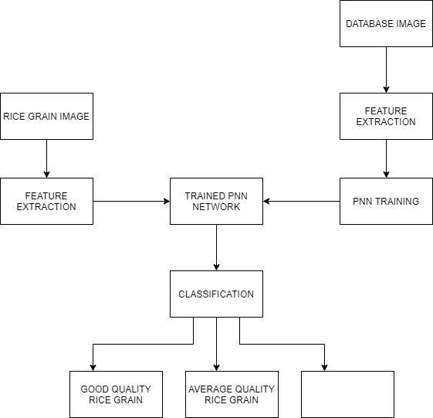
Block Diagram
BAD QUALITY
RICE GRAIN

Slide 32
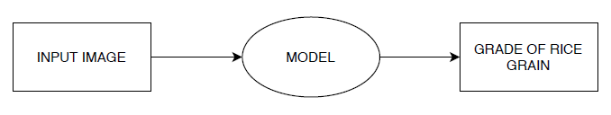
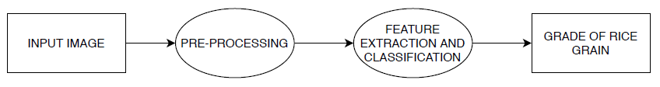
Data Flow Diagram Level 0 and Level 1
DFD Level 0
DFD Level 1

Slide 33
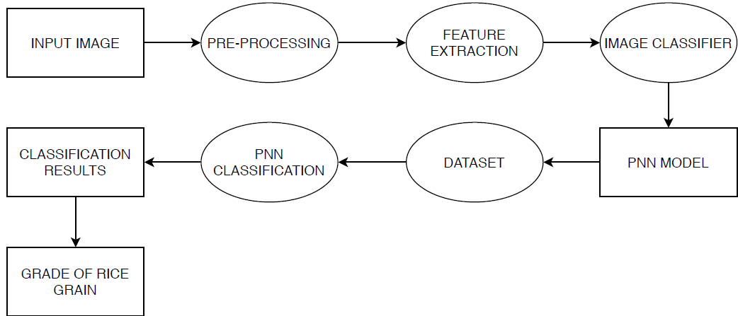
Data Flow Diagram Level 2

Slide 34
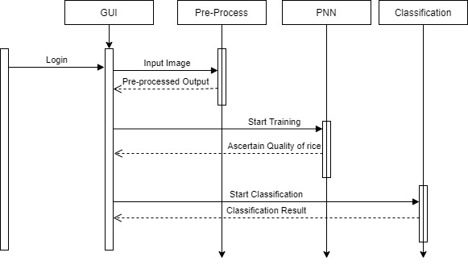
Sequence Diagram

Slide 35
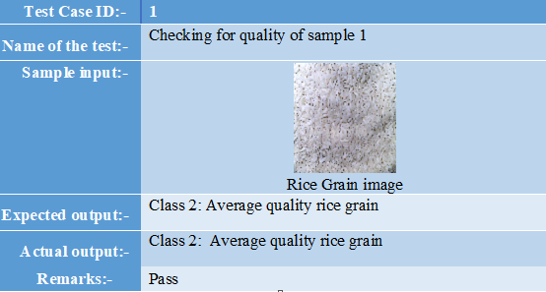
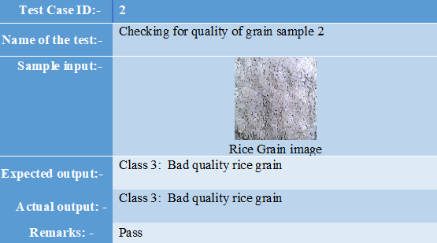
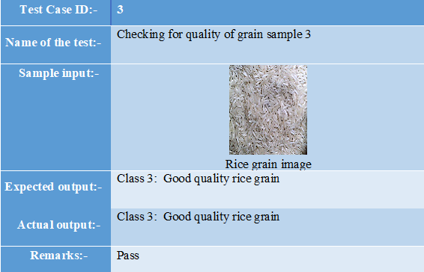
Test Cases

Slide 36
Results and Performance Evaluation
Recognition Rates
Results based on various Parameters
Type of rice grain | Recognition Rate
Good | 100%
Average | 100%
Bad | 100%
Metric | Value
Accuracy (Train) | 100%
Accuracy (Test) | 97.89%
Precision | 96.83%
Recall | 97.33%

Slide 37
Issues
One of the primary issues with the proposed system is the absence of online rice grain image processing.
Also, one of the pressing issues is, the availability of vast varieties of rice grains, which makes it difficult to label specific grains according to their quality
Notwithstanding, the major issue concerning our is that due to overlap of rice grain images many morphological features cannot be considered, which leads to higher degreed of accuracy

Slide 38
Future Enhancements
We have acquired images without any advanced technology enabled camera in research conditions. Acquiring of images could have been done under different lighting conditions.
The proposed method could be extended to a wide variety of other species of rice grains.
Further, our method can be extended to other food grains. The major research extension would be to optimize the neural network to increase the rate of accuracy.
Online rice grain image analysers is another major improvisation which could be done in the future.

Slide 39
References
[1] Qing Yao, Jianhua Chen, Zexin Guan, Chengxiao Sun, Zhiwei Zhu “Inspection of rice appearance quality using machine vision”, Global Congress on Intelligent Systems, 978-0-7695-3571-5/09, IEEE 2014.
[2] Yong Wu and Yi Pan “Cereal Grain Size measurement based on Image Processing Technology”, International Conference on Intelligent Control and Information Processing, August 13-15, 2015 - Dalian, China.
[3] Megha R. Siddagangappa, A. H. Kulkarni “Classification and Quality Analysis of Food Grains,” IOSR Journal of Computer Engineering (IOSR-JCE), Aug. 2014.

Slide 40
[4] Deepika Sharma et al “Grain Quality Detection by using Image Processing for public distribution”, International Conference on Intelligent Computing and Control Systems 978-1-5386-2745-7/17/ 2017
[5] Shraddha N. Shahane et al, “Grain Quality Assessment for Rationing System”, Online International Conference on Green Engineering and Technologies 978-1-5090-4556 ©2016 IEEE
[6] Harpreet Singh et al, “ Image Processing Techniques for Analysing Food Grains”, International Conference on Computing Methodologies Communication (ICCMC) 978-1-4244-7164-5 ©2019 IEEE
[7] Zahida Praveen et al, “ Assessment of Quality of Rice Grain using Optical and Image Processing Technique”, International Conference on Computing Methodologies Communication (ICCMC) 978-1-4244- 7164-5 ©2019 IEEE

Slide 41
Thank You

